Slide 1
Generalized Random Tessellation Stratified (GRTS) Spatially-Balanced Survey Designs for Aquatic Resources
Anthony (Tony) R. Olsen
USEPA NHEERL
Western Ecology Division
Corvallis, Oregon
Voice: (541) 754-4790
Email: olsen.tony@epa.gov

Slide 2
GRTS Developers
GRTS theory and algorithm
Don Stevens, Oregon State University
Tony Olsen, USEPA Western Ecology Division
spsurvey R package implementation
Tony Olsen, USEPA Western Ecology Division
Tom Kincaid, USEPA Western Ecology Division
Denis White, USEPA Western Ecology Division
Richard Remington, formerly USEPA Western Ecology Division
Christian Platt, formerly Dynamac Corp

Slide 3
Overview
Aquatic resource characteristics
Sample frame
GIS coverages
Imperfect representation of target population
GRTS implementation
GRTS spatial balance properties
GRTS theory (optional)

Slide 4
Features in Space as GIS objects
Feature | Points | Lines | Polygons
Lakes | Individual lakes |  | Lake area
Streams | Segments | Linear network
Coastal Waters |  |  | Estuarine area
Wetlands | Depressional wetlands |  | Wetland area
Roads/trails |  | Linear network
Hydrologic Units | As points |  | As areas
Terrestrial Vegetation |  |  | As areas

Slide 5
Natural Resource Characteristics
Types of natural resources
Area polygons: large lakes and reservoirs, estuaries, coastal waters, everglades, forests, landscapes
Linear networks: streams, rivers, roads, trails
Discrete points: small lakes, stream reaches, prairie pothole wetlands, hydrologic units (“watersheds”), buildings
Target population
Finite in a bounded geographic region: collection of points
Continuous in a bounded geographic region
As linear network
As collection of polygonal areas
Generalizations
Geographic region may be 1-dimensional (p-dimensional)
“Space” may be defined by other auxiliary variables

Slide 6
Typical Aquatic Sample Frames
GIS coverages do exist for aquatic resources
National Hydrography Dataset (NHD)
Based on 1:100,000 USGS maps
Combination of USGS Digital Line Graph (DLG) data set and USEPA River Reach File Version 3 (RF3)
Includes lakes, ponds, streams, rivers
Sample frames derived from NHD
Use GIS to extract frame to match target population
Enhance NHD with other attributes used in survey design
Issues with NHD
Known to include features not of interest (over-coverage)
Known to exclude some aquatic resources (under-coverage)

Slide 7
Generalized Random Tessellation Stratified (GRTS) Survey Designs
Probability sample producing design-based estimators and variance estimators
Gives another option to simple random sample and systematic sample designs
Simple random samples tend to “clump”
Systematic samples difficult to implement for aquatic resources and do not have design-based variance estimator
Emphasize spatial-balance
Every replication of the sample exhibits a spatial density pattern that closely mimics the spatial density pattern of the resource

Slide 8
GRTS Implementation Steps
Concept of selecting a probability sample from a sampling line for the resource
Create a hierarchical grid with hierarchical addressing
Randomize hierarchical addresses
Construct sampling line using randomized hierarchical addresses
Select a systematic sample with a random start from sampling line
Place sample in reverse hierarchical address order

Slide 9
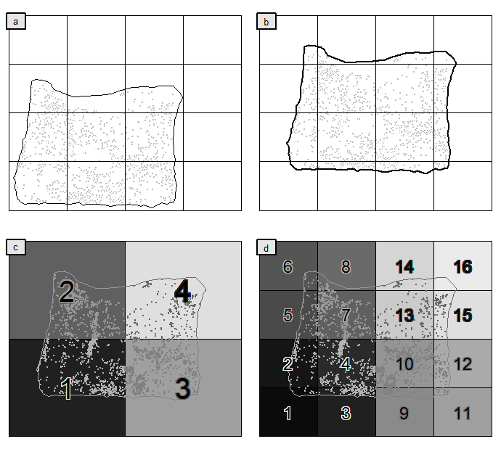
Construct Hierarchical Grid on Sample Frame
Sample frame placed within systematic grid with extra row and column of empty grid cells with the grid size determined by the sample size and distribution of the elements to be sampled
Sample frame randomly shifted
First level hierarchical ordering of grid cells (m=1)
Second level hierarchical ordering of grid cells (m=2).

Slide 10
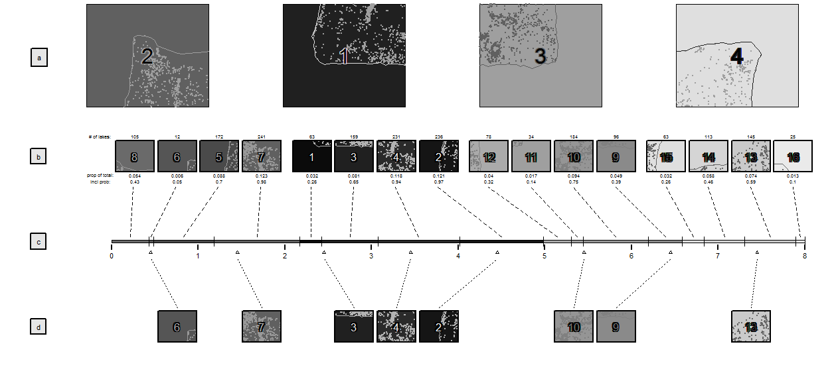
Cell Selection Process
Random ordering of hierarchical levels (a) & (b), creation of sampling line (c top), systematic sample of cells (c bottom), selected eight cells (d)

Slide 11
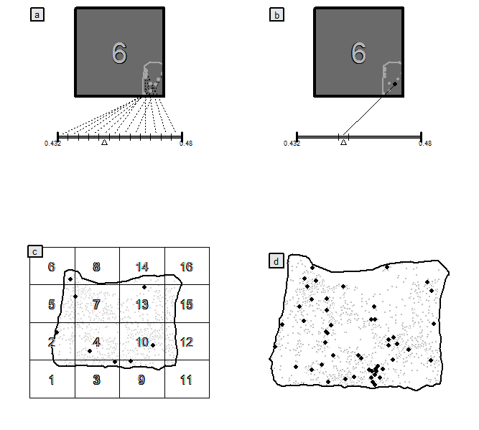
Random Selection of Lake within Cell
Random ordering of lakes on line with equal length assigned to each lake
Selection of lake when random location of point occurs within the lake’s line segment
GRTS sample of size eight
GRTS sample of size 50 where number of hierarchical levels determined so that total inclusion probability of each grid cell was <1

Slide 12
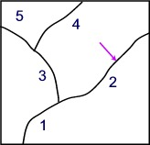
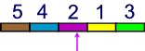
Selecting a Probability Sample from a Sampling Line: Linear Network Case
Place all stream segments in frame on a linear line
Preserve segment length
Identify segments by ID
In what order do place segments on line?
Randomly
Systematically (minimal spanning tree)
Randomized hierarchical grid
Systematic sample with random start
k=L/n, L=length of line, n=sample size
Random start d between [0,k)
Sample: d + (i-1)*k for i=1,…,n
Notes:
Notes:
1. if want to select a simple random sample then randomly select n numbers between [0,L].
2. If want to select a systematic sample, then place segments on line “systematically” and then select systematic sample with a random start.

Slide 13
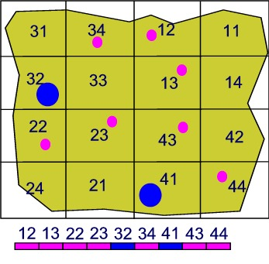
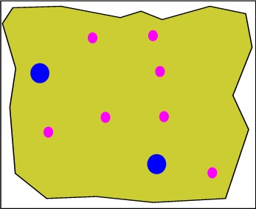
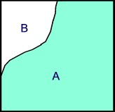
Selecting a Probability Sample from a Sampling Line: Point and Area Cases
Point Case:
Identify all points in frame
Assign each point unit length
Place on sample line
Area Case:
Create grid covering region of interest
Generate random points within each grid cell
Keep random points within resource (A)
Assign each point unit length
Place on sample line

Slide 14
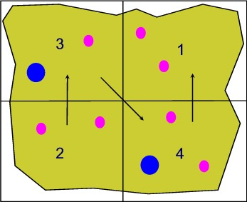
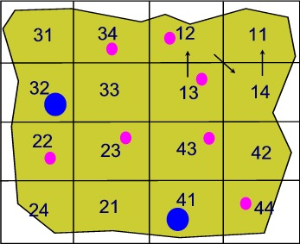
Randomized Hierarchical Grid
Step 1
Step 2
Step 3
Step 4
Step 1: Frame: Large lakes: blue; Small lakes: pink; Randomly place grid over the region
Step 2: Sub-divide region and randomly assign numbers to sub-regions
Step 3: Sub-divide sub-regions; randomly assign numbers independently to each new sub-region; create hierarchical address. Continue sub-dividing until only one lake per cell.
Step 4: Identify each lake with cell address; assign each lake length 1; place lakes on line in numerical cell address order.

Slide 15
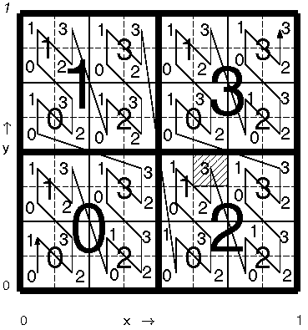
Hierarchical Grid Addressing
213: hierarchical address

Slide 16
Population of 120 points

Slide 17
Reverse Hierarchical Order
RHO | Reverse Base4 | Base4 | Original Order
1 | 00 | 00 | 1
2 | 01 | 10 | 5
3 | 02 | 20 | 9
4 | 03 | 30 | 13
5 | 10 | 01 | 2
6 | 11 | 11 | 6
7 | 12 | 21 | 10
8 | 13 | 31 | 14
9 | 20 | 02 | 3
10 | 21 | 12 | 7
11 | 22 | 22 | 11
12 | 23 | 32 | 15
13 | 30 | 03 | 4
14 | 31 | 13 | 8
15 | 32 | 23 | 12
16 | 33 | 33 | 16
Construct reverse hierarchical order
Order the sites from 1 to n
Create base 4 address for numbers
Reverse base 4 address
Sort by reverse base 4 address
Renumber sites in RHO
Why use reverse hierarchical order?
Results in any contiguous set of sample sites being spatially-balanced
Consequence: can begin at the beginning of list and continue using sites until have required number of sites sampled in field

Slide 18
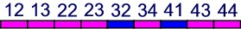
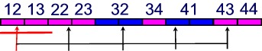
Unequal Probability of Selection
Assume want large lakes to be twice as likely to be selected as small lakes
Instead of giving all lakes same unit length, give large lakes twice unit length of small lakes
To select 5 sites divide line length by 5 (11/5 units); randomly select a starting point within first interval; select 4 additional sites at intervals of 11/5 units
Same process is used for points and areas (using random points in area)

Slide 19
Complex Survey Designs based on GRTS
Stratified GRTS: apply GRTS to each stratum
Unequal probability GRTS: adjust unit length based on auxiliary information (eg lake area, strahler order, basin, ecoregion)
Oversample GRTS:
Design calls for n sites; some expected non-target, landowner denial, etc; select additional sites to guarantee n field sampled
Apply GRTS for sample size 2n; place sites in RHO; use sites in RHO
Panels for surveys over time
Nested subsampling
Two-stage sampling using GRTS at each stage
Example: Select USGS 4th field Hucs; then stream sites within Hucs

Slide 20
GRTS Examples

Slide 21
Two GRTS samples: Size 30

Slide 46
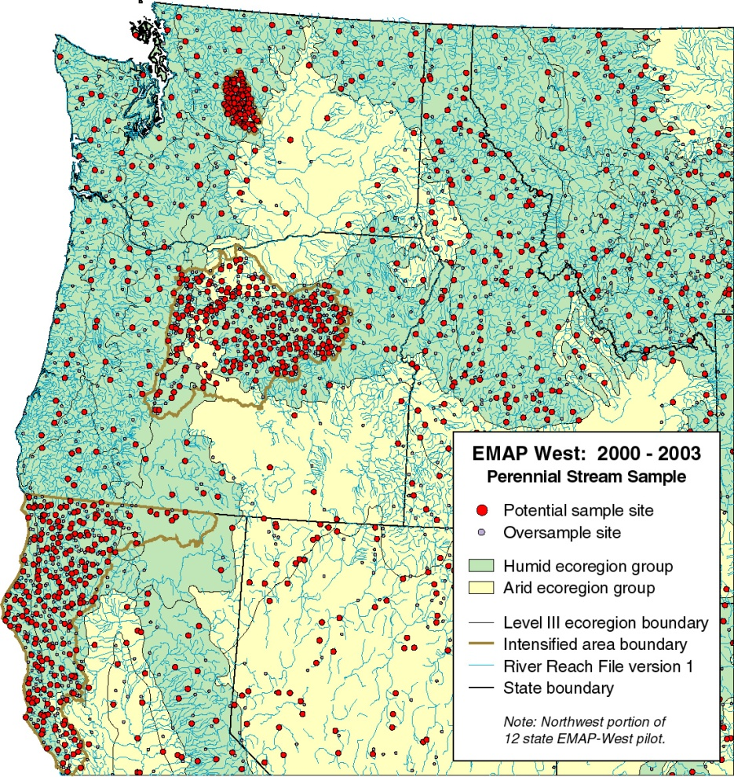
Perennial Streams GRTS sample

Slide 47
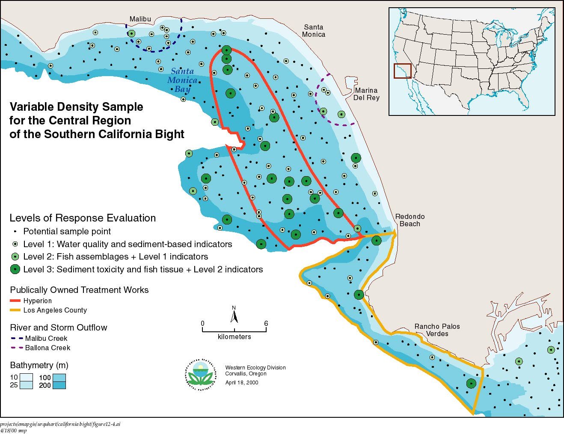

Slide 48
RF3 Sample Frame: Lakes

Slide 50
Sample Selected: Lakes

Slide 51
GRTS Sample of Streams

Slide 52
GRTS Spatial Balance Properties

Slide 53
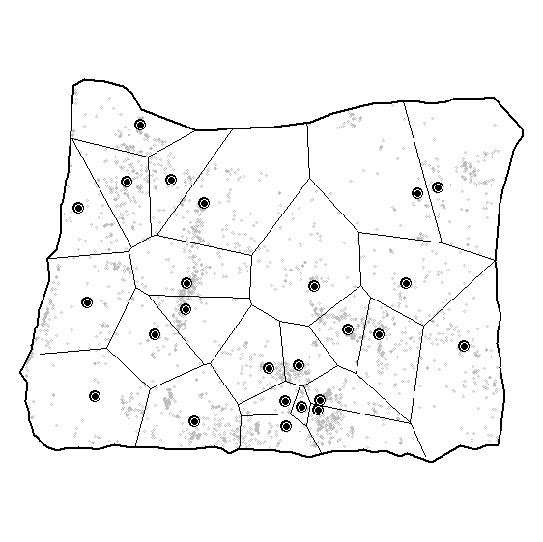
Direchlet tessellation for a sample of size 25 from Oregon lake population

Slide 54
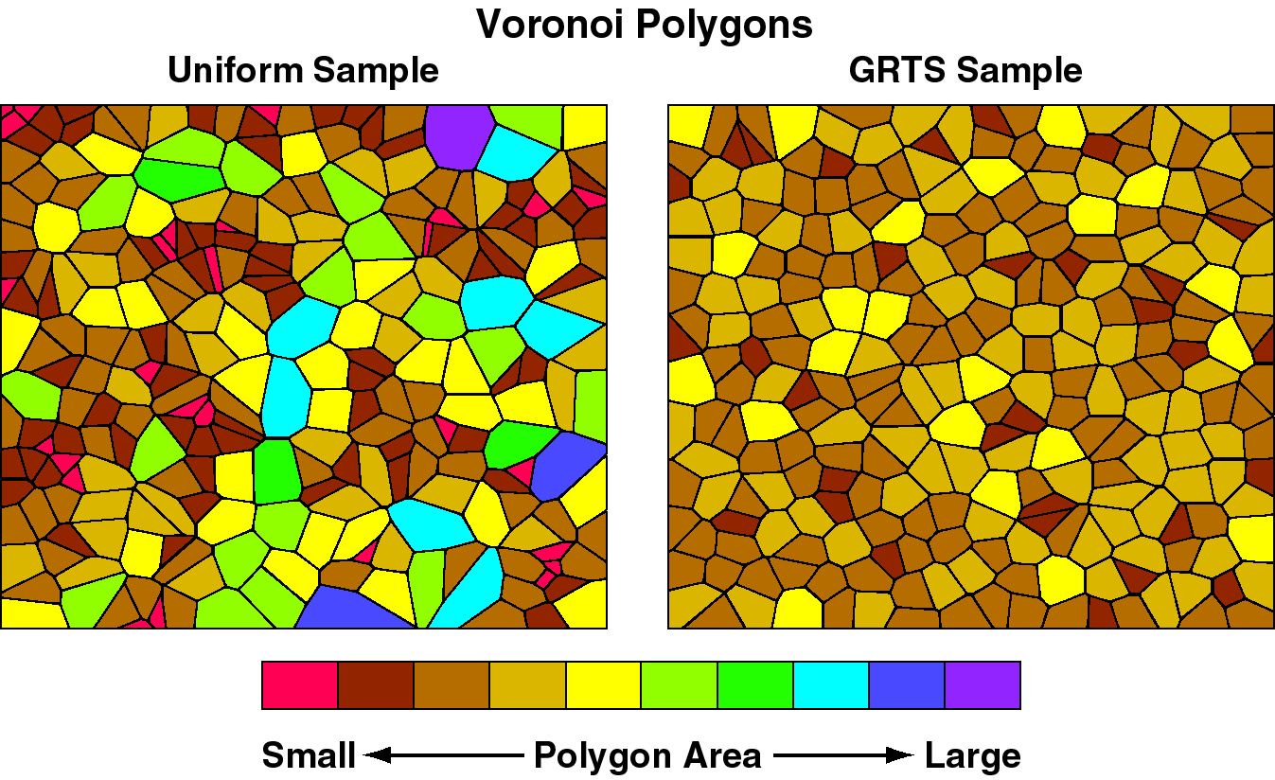
Spatial Balance: 256 points

Slide 55
SPATIAL PROPERTIES OF REVERSE HIERARCHICAL ORDERED GRTS SAMPLE
Compare regularity as points are added one at a time, following reverse hierarchical order under 4 scenarios:
Complete, continuous domain
Domains with “holes” excluding 20 %, modeling non-response/access refusal
20 randomly-located square holes, constant size
20 randomly-located square holes, increasing linearly in size
10 randomly-located square holes, increasing exponentially in size
Holes model inaccessibility…elements that are in target domain, but cannot be sampled for some reason

Slide 57
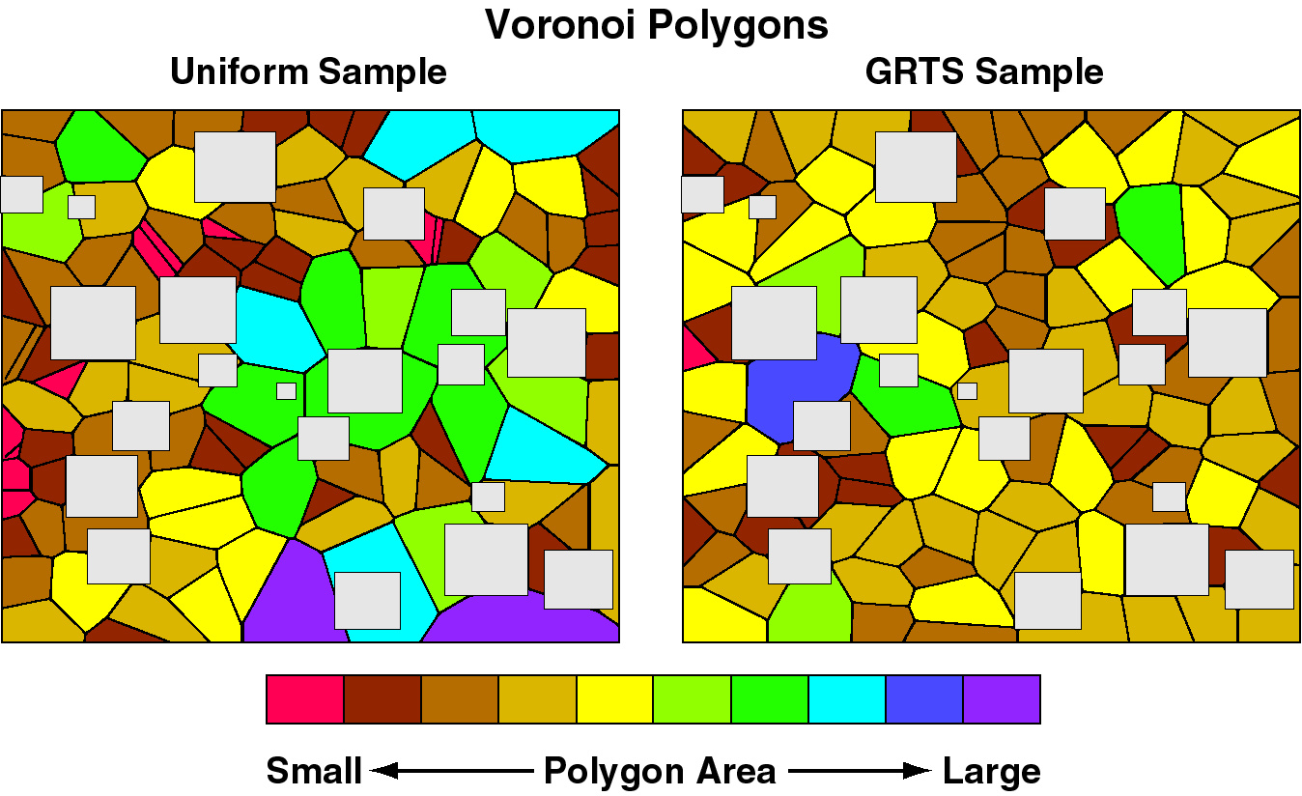
Spatial Balance: With oversample

Slide 58
Ratio of GRTS to SRS Voronoi polygon size variance

Slide 59
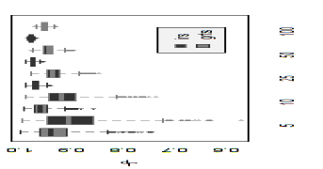
Spatial Balance Performance GRTS and IRS
Oregon lake population
Evenness spatial balance metric results for
1000 simulated GRTS samples for sample sizes 5, 10, 25, 50, and 100
1000 simulated IRS samples for sample sizes 5, 10, 25, 50, and 100
Values closer to 1 exhibit more spatial balance

Slide 60
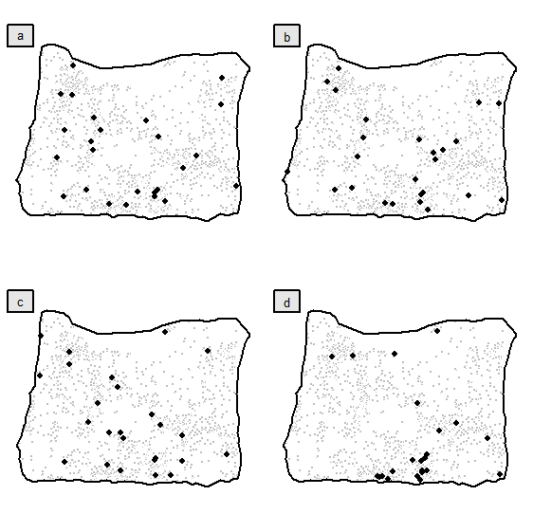
Extreme Samples from 1000 simulated samples
GRTS most spatially-balanced,
IRS most spatially-balanced,
GRTS least spatially-balanced,
IRS least spatially-balanced

Slide 61
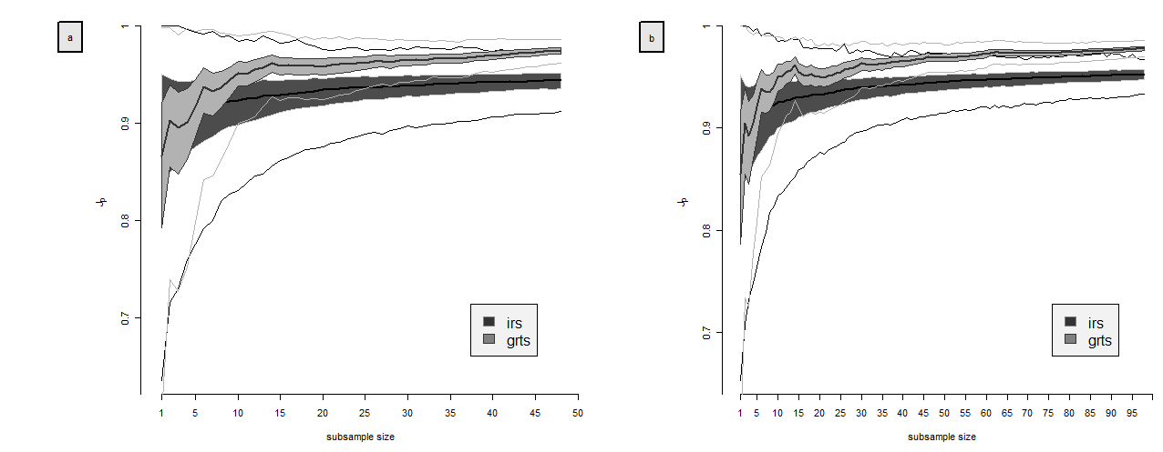
Spatial balance properties as a function of sample size for GRTS and IRS: Evenness diversity metric
Samples based on 1000 simulations of the Oregon lake population
Sample points were added one point at a time up to the maximum sample sizes of 50 or 100.
GRTS samples are arranged in reverse hierarchical order

Slide 62


Slide 63
Theoretical Development of GRTS

Slide 64
Generalized Random-Tessellation Stratified (GRTS) Design
Conceptual structure:
Population indexed by points contained within a region R
Have inclusion probability p(s) defined on R
Select a sample by picking points
Finite: points represent units
p(s) is inclusion probability
Linear: points on the lines
p(s) is a density: E(#sample points) /unit length
Extensive: points are in region area
p(s) is a density: E(#sample points)/unit area

Slide 65
GRTS Design Mechanics
Map R into first quadrant of unit square, & add a random offset
Subdivide unit square into “small” grid cells
At least small enough so that total inclusion probability for a cell (expected number of samples in the cell) is less than 1
Total inclusion probability for cell is sum or integral of p(s) over the extent of the cell

Slide 66
Population region image

Slide 67
Population region image + random offset

Slide 68
GRTS Design Mechanics
Order the cells so that some 2-dimensional proximity relationships are preserved
Can’t preserve everything, because a 1-1, onto, continuous map from unit square to unit interval is impossible
Can get 1-1,onto, & measurable, which is good enough
GRTS uses a quadrant-recursive function, similar to the space filling curve developed by Guiseppe Peano in 1890.

Slide 69
Assign each cell an address corresponding to the order of subdivision
The address of the shaded quadrant is 0.213
Order the cells following the address order

Slide 70
GRTS Design Mechanics
If we carry the process to the limit, letting the grid cell size → 0, the result is a quadrant recursive function, that is, a function that maps the unit square onto the unit interval such that the image of every (sub) quadrant is an interval.
The resulting function is 1-1, onto, and measurable.
Apply a restricted randomization that preserves quadrant recursiveness.

Slide 71
HIERARCHICAL RANDOMIZATION
Each cell address is a base 4 fraction, that is, t = 0.t₁t₂t₃..., where each digit t_{i} is either a 0, 1, 2, or 3. A function h_{p} is a hierarchical permutation if
where is a possibly distinct permutation of {0,1,2,3} for each unique combination of digits t₁, t₂, ..., t_{n - 1}.
Every time a cell is sub-divided, we choose a random permutation to order the sub-quadrants.

Slide 72
HIERARCHICAL RANDOMIZATION
If the permutations that define h_{p}(·) are chosen at random and independently from the set of all possible permutations, we call h_{p}(·) a hierarchical randomization function, and the process of applying h_{p}(·) hierarchical randomization.
Compose the basic q-r map with a hierarchical randomization function to get a random, quadrant-recursive function.

Slide 73
Start →
← Start

Slide 74
GRTS Design Mechanics
The result is a random order of the “small” grid cells such that
All grid cells in the same quadrant have consecutive order positions
But will be randomly ordered within those positions
This holds for all quadrant levels
This induces a random ordering of population elements

Slide 75
GRTS Design Mechanics
Assign each grid cell a length equal to its total inclusion probability
String the lengths in the random order
Result is a line with length equal to target sample size
Take systematic sample along line (random start + unit interval)
Map back to population using inverse random q-r function

Slide 76
GRTS DESIGN
Let
I R = (0, 1] I R ² = (0, 1] ×(0, 1]
φ(s) be a measure on I R ² (number, length, area)
π(s) be an inclusion intensity function on I R ²
f : I R² → R I be a hierarchically randomized quadrant recursive function

Slide 77
GRTS DESIGN
Map population domain R into (0, ½]×(0, ½],
add random offset to get image R* ⊂ R ²
Set R
F(x) is a random distribution function with range (0, M]

Slide 78
GRTS DESIGN
Pick u₁ < u₂ < …< u_{M} as a systematic sample with random start from (0, M] (u_{i} = r + i -1, r ~ U(0,1))
Set v_{i} = F⁻¹(u_{i}) and s_{i} = (s_{i,x} , s_{i,y} ) = f ⁻¹(v_{i})
Then S = {s₁, s₂, …,s_{M} } is a spatially well-balanced sample from the target population with the desired inclusion function.

Slide 79
quadrant-recursive, hierarchical random map
x=f(s)
s
0 1
x
B(x) = {s|0 ≤ f(s) ≤ x}
F(x) = ∫ π(s)dφ(s)
B(x)
y
M
.
.
s =f⁻¹(x)
y
.
i
.
systematic
F(x)
.
sample
.
y
2
y
1
x
1
x
2
.
.
.
x
i
.
.
.
x
M
x=F⁻¹(y)

Slide 80
GRTS Design Mechanics
Points will be in ‘hierarchical random order’
Re-order into ‘reverse hierarchical order’ gives some very useful features to the sample

Slide 81
Reverse Hierarchical Order
Illustrate for 2-levels of addressing:
First 16 addresses as base 4-fractions
00 01 02 03 10 11 12 13 20 21 22 23 30 31 32 33

Slide 82
Reverse Hierarchical Order
Illustrate for 2-levels of addressing:
First 16 addresses as base 4-fractions
00 01 02 03 10 11 12 13 20 21 22 23 30 31 32 33
Reversed digits
00 10 20 30 01 11 21 31 02 12 22 32 03 13 23 33

Slide 83
Reverse Hierarchical Order
Illustrate for 2-levels of addressing:
First 16 addresses as base 4-numbers
00 01 02 03 10 11 12 13 20 21 22 23 30 31 32 33
Reversed digits
00 10 20 30 01 11 21 31 02 12 22 32 03 13 23 33
Reversed digits as base 10 numbers
0 4 8 12 1 5 9 13 2 6 10 14 3 7 11 15

Slide 84
Reverse Hierarchical Order
The above algorithm works for sample sizes that are powers of 4, i.e., n = 4^{k}
For other values of sample, need to modify:
Let k be smallest integer such that n ≤ 4^{k}
Form the reverse hierarchical order for the integers 1,,,, 4^{k}
Scale the ordered integers to the range (1, n)
Eliminate any duplicates
For example, let n = 12
Then k = 2, so that 4^{k} = 16
RHO(16) = (1, 5, 9,13, 2, 6,10,14, 3, 7, 11, 15, 4, 8,12, 16)
RHO(12) = (1, 4, 7,10, 2, 5, 8,11, 3, 6, 9, 12)

